Slide 1

! Space Geeks
RNA Cosmos: Visualizing Genetic Responses to Space

Slide 2
Introduction To Our Challenge
The challenge is to develop a scalable tool that generates clear and engaging visualizations of biological experiments conducted in space, specifically on the ISS. This tool should help scientists quickly understand complex experiments, like Rodent Research Reference Mission-1 (OSD-379) and Rodent Research-23 (OSD-665), by visualizing key data and experimental features, enhancing the accessibility and interpretation of spaceflight research data.

Slide 3
Introduction To Our Solution
RNA Cosmos is an interactive web platform designed for bio scientists and space scientists to visualize RNA sequence data, focusing on the differences between mice in three different habitats: one in space and two on Earth. The platform presents data from two experiments, RNA expression in the liver and the right extensor digitorum longus muscle through interactive plots. These visualizations make it easy for experts to explore and compare biological responses across different environments, helping them to derive insights into how space conditions affect gene expression and overall biological processes.

Slide 4
Our Solution Benefits
Improved understanding of RNA differences between space and Earth mice.
Interactivity and user-friendly
Interactive exploration of RNA data through plots.
Promotion of open access to research data.
Insights to support biological challenges in space missions.
Resource for educational purposes on space effects.

Slide 5
Utilized Tools
&
Resources
Python
Dash
HTML & CSS
NASA Open Science Data Repository
Colab, VSCode, Jupyter

Slide 6
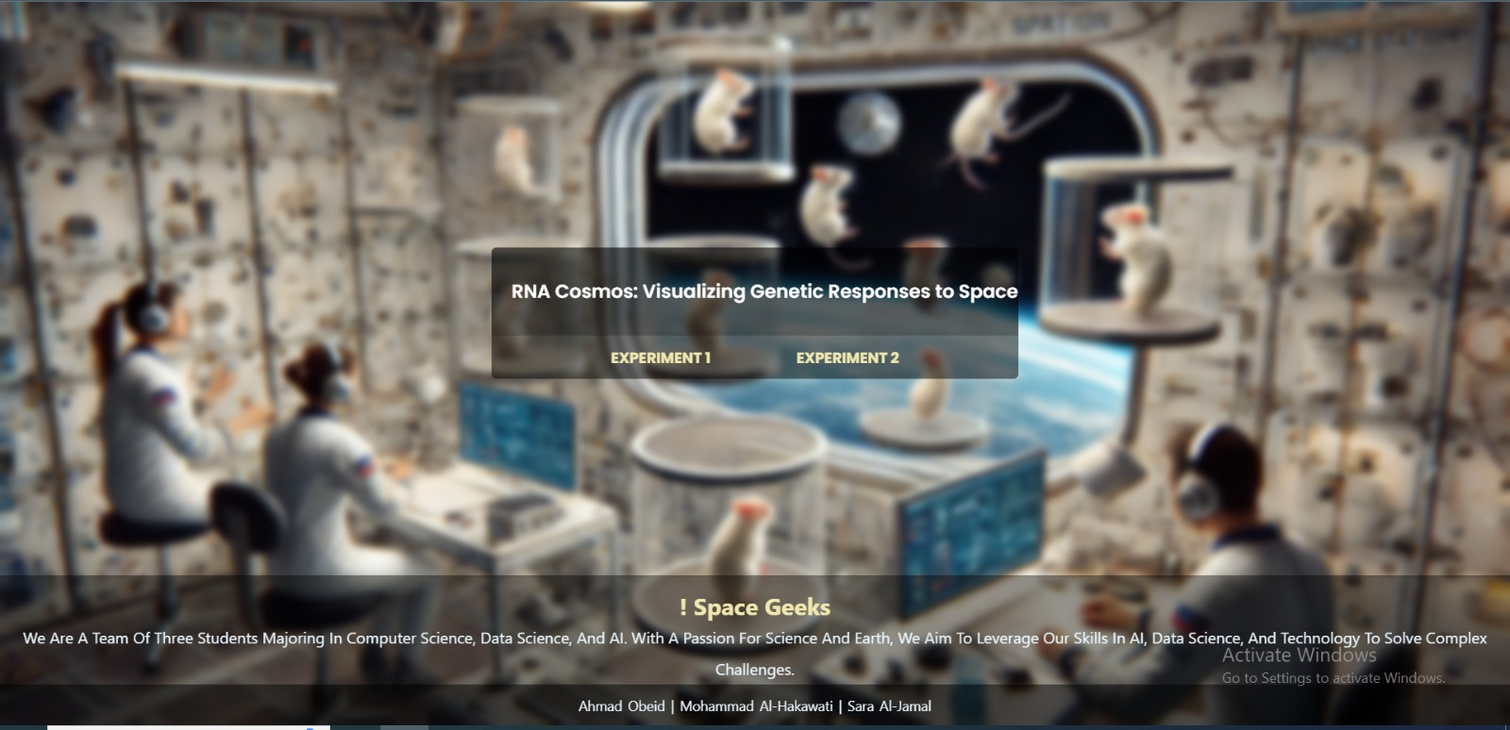
Our Solution Overview

Slide 7
Key Findings
Minimal Environmental Impact on RNA data like total sequences, percent duplicates, and deduplicated percentages, seem only slightly influenced by the environment.
The GC content appears to differ between environments, with VIV and FLT environments often higher quality results.
In the ISS, sequences and deduplicates are generally higher, suggesting potential space-specific biological responses in RNA behavior compared to Earth.
Age have an influence on RNA data, with older mice showing better results in terms of sequences and deduplication, hinting at age-related biological factors.

